Slide 1
Polishing Your Game Through Adobe Mixamo
By Veeti Alatalo

Slide 2
Introduction
Animations are difficult and incredibly time consuming, which is why many of you are likely moving away from fully fletched character models for your finals, and using easier options instead. As it turns out, many other Video Game Designers and coders feel the same way. Because of this, a larger percentage of indie games do not actually use their own animations, but rather modify or straight up utilize resources like Mixamo for easy to implement, high quality animations for their games.
It takes a few minutes to create your animations, and in this presentation we will go through that.

Slide 3
What is Mixamo?
Mixamo is a library of motion captured character animations by Adobe.
Free to use by making an Adobe Account (no subscriptions required)
Allows easy mapping and exporting to multiple projects including Unity

Slide 4
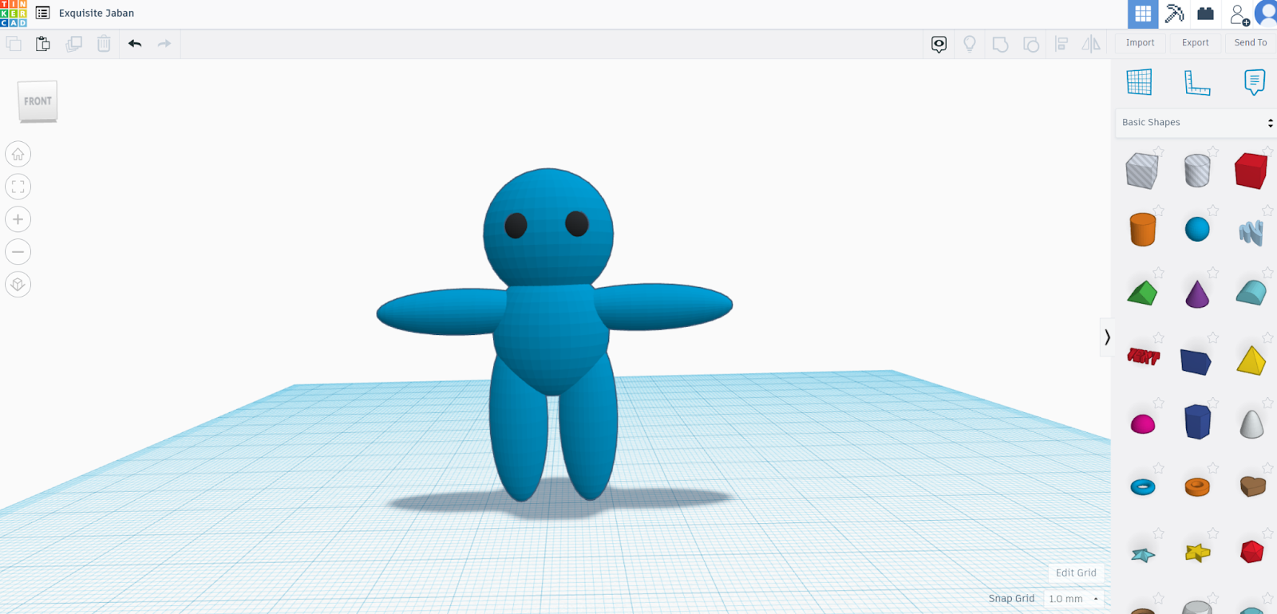
Step 1: Make your Character T-pose
Whatever software you use to make your models, having your characters in a T-pose is important since it allows for animation programs and resources to better recognize parts of your asset. This allows for much easier and higher quality mapping
I used TinkerCad to make my model since it is easy and free, but any other program works that supports exporting in .obj, .fbx, etc.

Slide 5
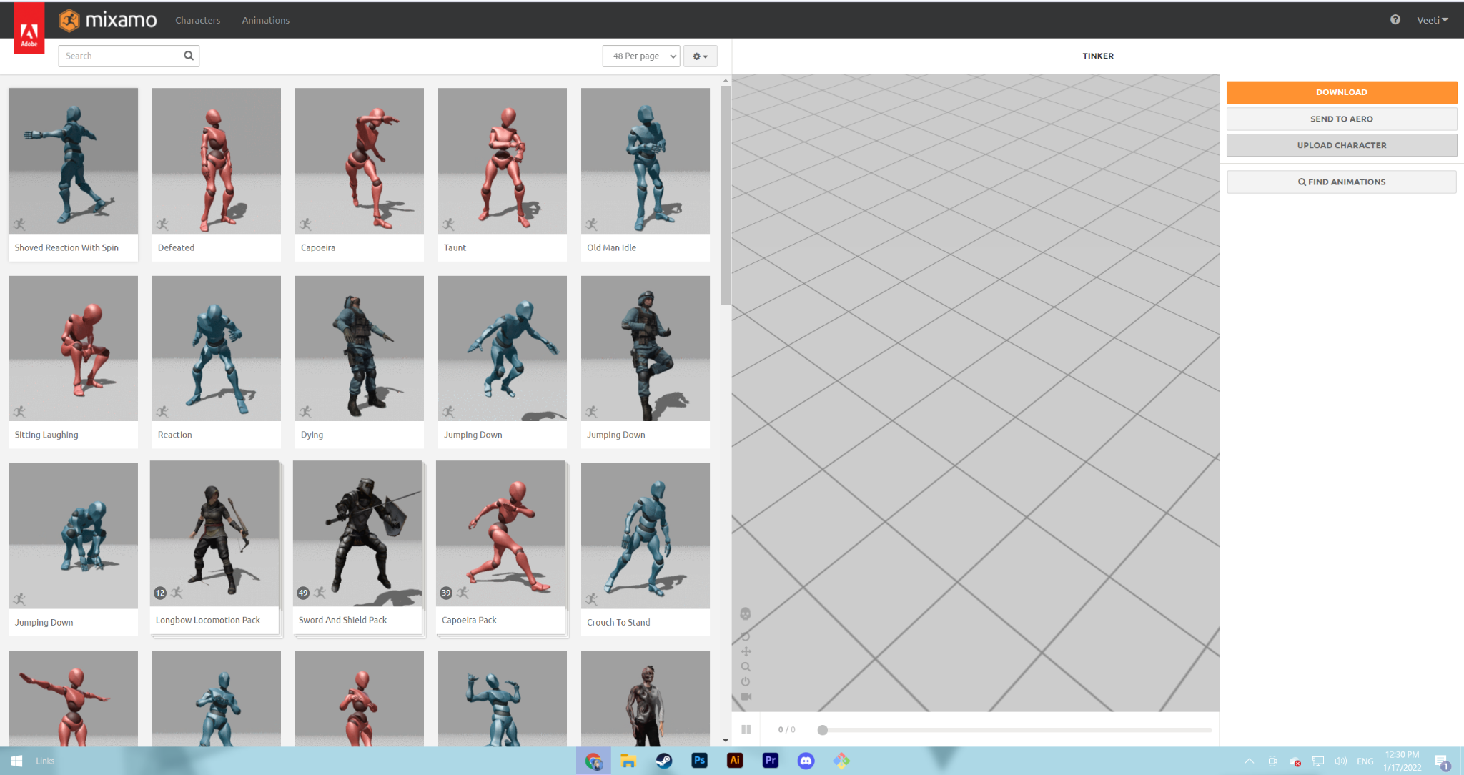
Step 2:
Go to mixamo.com and log in/create an Adobe account
You will be brought to the animations screen after logging in

Slide 6
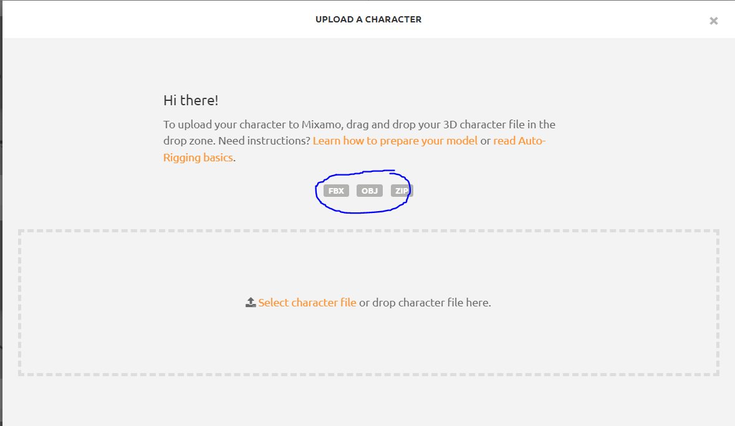
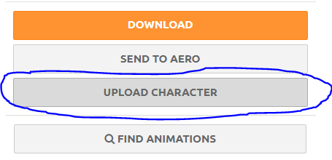
Step 3:
Export your character from your modeling program, and upload it to Mixamo
Note accepted formats —----------->

Slide 7
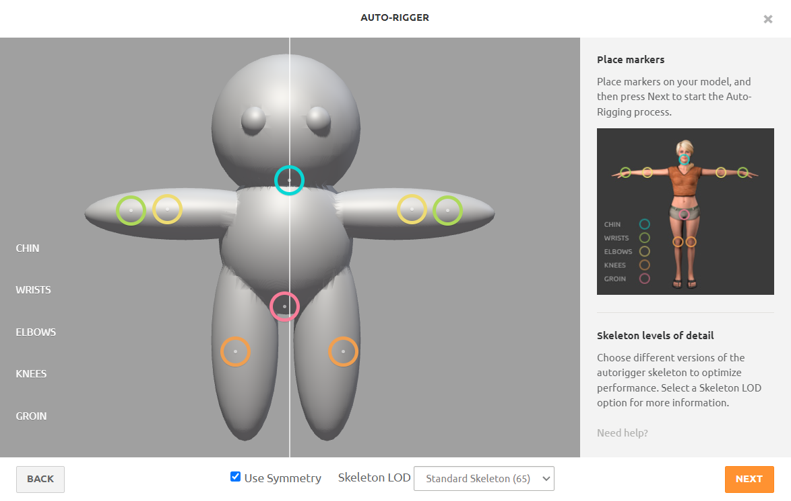
Step 4: Map your character
If your model is asymmetrical, uncheck use symmetry and drag each portion individually
It is okay to guestimate where portions would be. They do not HAVE to be perfectly defined in your model
It will take a few minutes to map everything

Slide 8
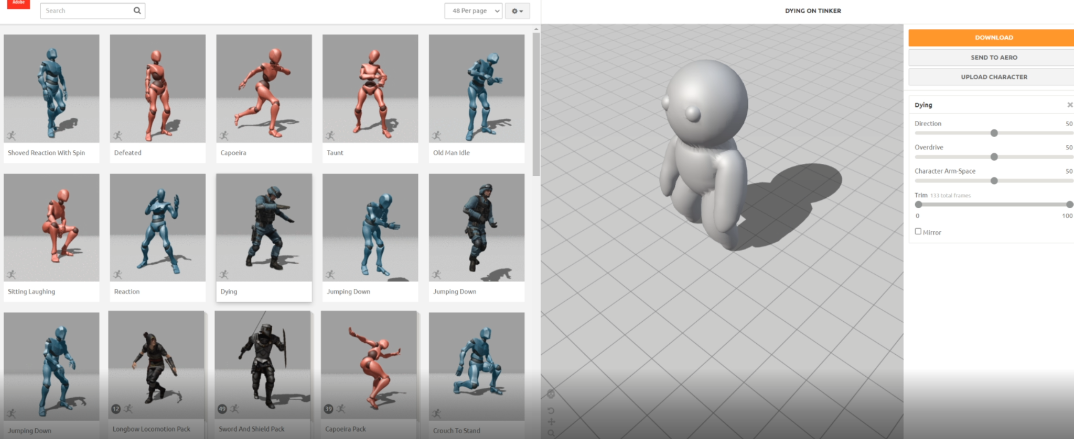
Congrats, you have a model

Slide 9
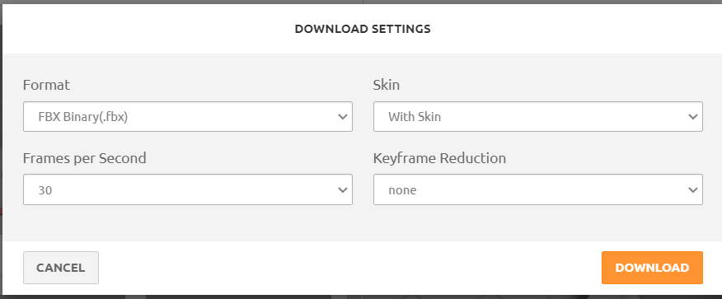
Final Step: Choose animations and export
Search for animations that you want to use, and once you find one and play around with its settings if you want, export
The settings below should work for Unity, but it can be case sensitive depending on what you are doing. Default is generally what you can trust will work for 99% of the time
Follow animations guide in Create With Code to implement

